Slide 1
Multimedia Presentation
ZABROVSKIY ANATOLIY
http://itmultimedia.ru
BLOG: itmultimedia.ru, 24.05.2012

Slide 2
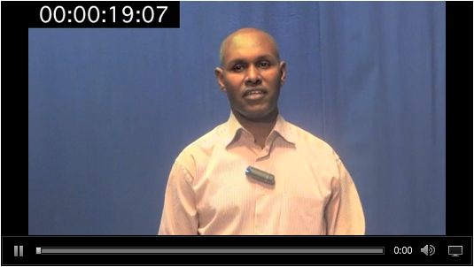
Special Flash Player
Some Info from Player
Database
Anatoliy Zabrovskiy
http://itmultimedia.ru
Multimedia

Slide 3
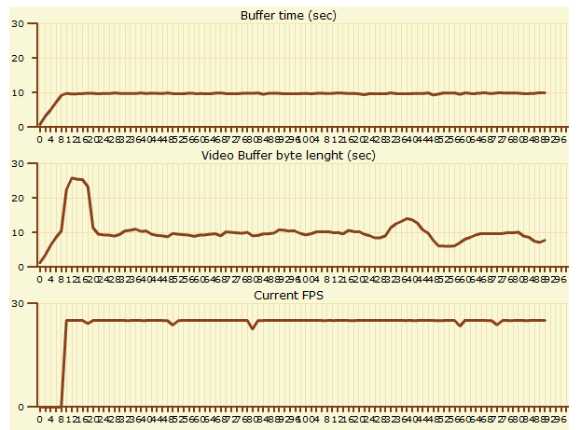
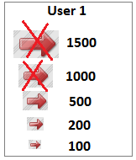
Mathematical model. How it works?
Database
Software application
Administrative interface
Anatoliy Zabrovskiy
http://itmultimedia.ru
Multimedia

Slide 4
Web Meetings. BigBlueButton application
Anatoliy Zabrovskiy
http://itmultimedia.ru
Multimedia

Slide 5
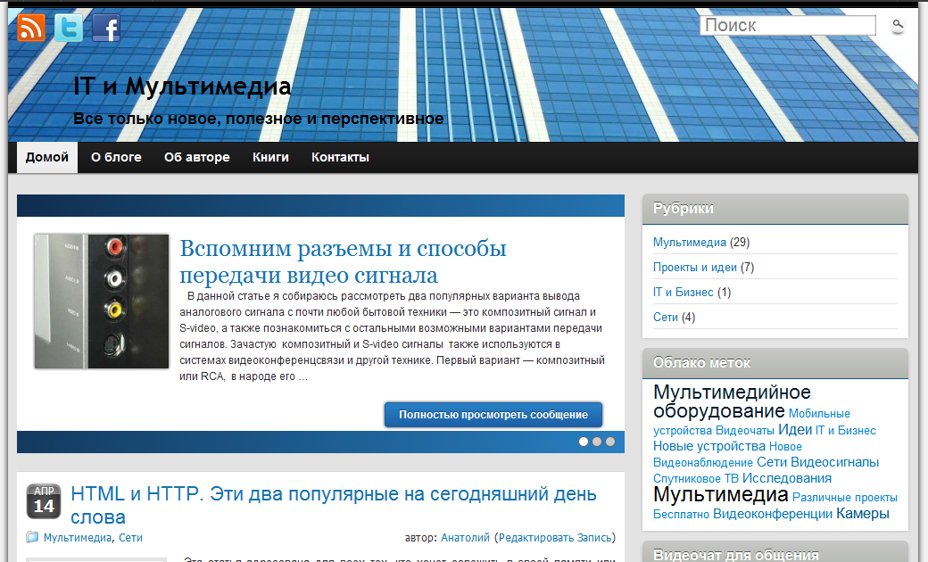
Blog: IT and Multimedia (http://itmultimedia.ru)
11 advantages of using a blog for teaching
Anatoliy Zabrovskiy
http://itmultimedia.ru
Multimedia

Slide 6
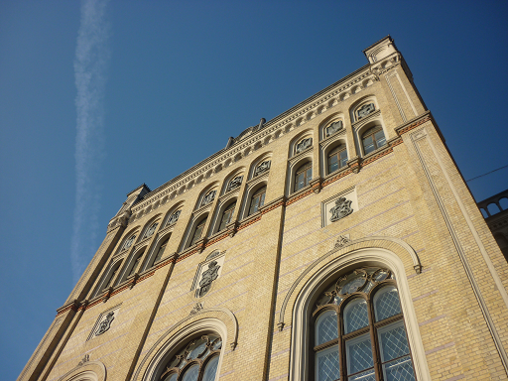
Thank you for your attention!
Anatoliy Zabrovskiy
http://itmultimedia.ru
Thank you

